Slide 1
Online Shopping
TO 414 Final Presentation
Greg Cervenak, Emma Phillipson, Emily Harvey, Thejas Suvarna, Abby Austin

Slide 2



Problem and Dataset Overview
Dataset
Online Shopping
Provided by Kaggle
Tracks if someone will make a purchase based on a set of characteristics
Guiding Question to
Answer
Can you predict if someone will make a purchase?
If so, what factors are important?
If not, why are we not able to?
Initial Hypothesis
Yes, we believe this will be possible.
There are certain characteristics that drive our own purchase habits and we think that the general population will be similar

Slide 3










Key Metrics in the Data Set
Administrative
Informational
Exit and Bounce Rates
Days and Months
Operating and Hardware
Product Related
Visitor Type
Page Values
Traffic Type
Browser

Slide 4
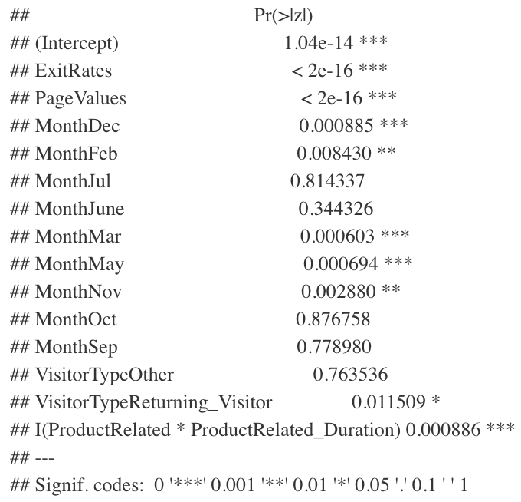

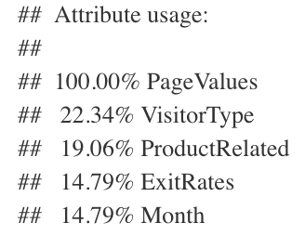
Our analysis revealed four major drivers of purchase behavior
Page Values
Product Related
Dependent pages influence purchases
Time spent researching the product leads to purchase
Exit Rates
Month
High exit rates indicate this page may be difficult to purchase from
Black Friday may have a large impact on purchases

Slide 5
Three are four main takeaways from this study
Page Values
High Page Value indicates that the page has been linked to by many other reputable web pages → we can triage areas where this metric is not high by reallocating advertising budget to pages that fail in this regard
1
Product
Using cookies, we can track where consumers have spent most of their time researching specific products, and target based on this
2
Exit
Rates
We will know which pages convert fewer customers based on exit rates → these pages should be redesigned to streamline the purchase experience
3
Month
There are specific months with higher purchase rates, such as November
We should target low purchase months with more aggressive advertising
4

Slide 6
Questions?
Thank you.
Greg Cervenak, Emma Phillipson, Emily Harvey, Thejas Suvarna, Abby Austin

